Slide 1
ANALYSIS OF CUSTOMER SATISFACTION BASED ON RECOMMENDATION STATUS.
BY: BALA MAIRIGA ABDULJALIL
17TH , APRIL; 2023.

Slide 2
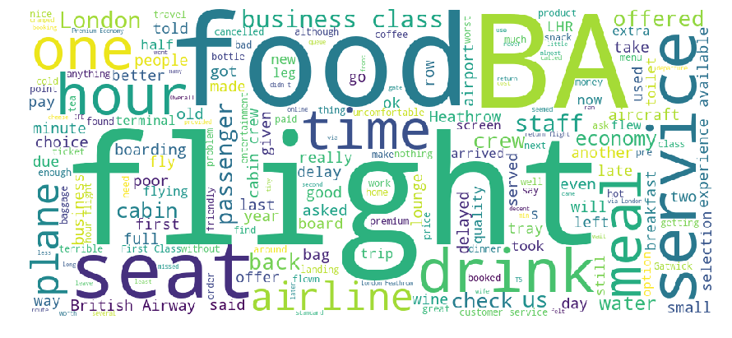
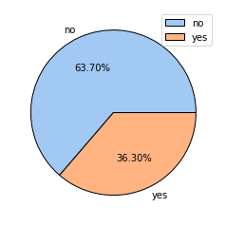
CUSTOMER SATISFACTION From the 1000 customer dataset reviewed, it was indicated that 63.7% of the customer recommend British airway and only 36.3% say no to British airway due to certain reason such as late flight, seat number and food delivery as indicated from the Wordcloud analysis.

